Slide 1
The robot follows a certain path strategy to find and matche character
2
Match successfully
Match failed
Save character image and name
Match successfully
The robot rotates 360 degrees while template matches
1
The robot walks to the center of the room

Slide 2
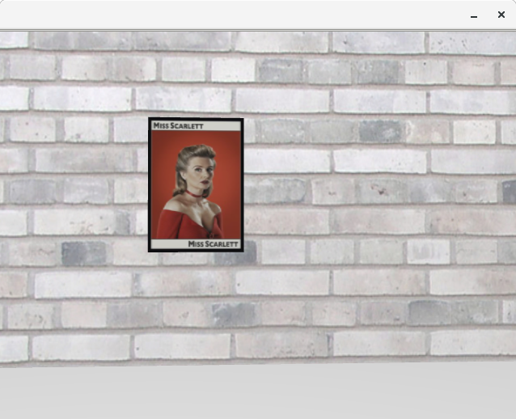
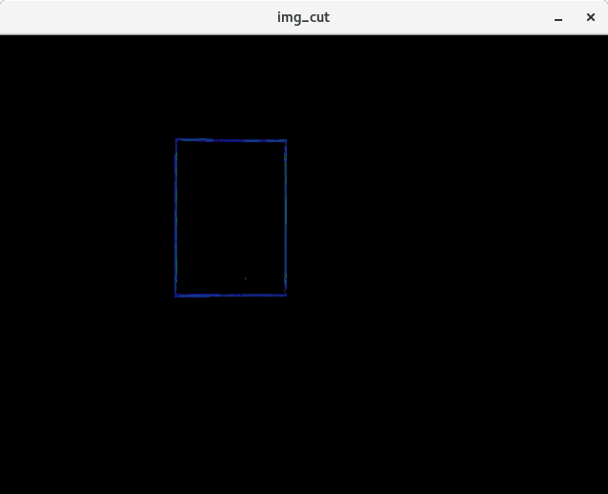

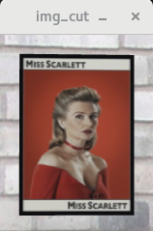
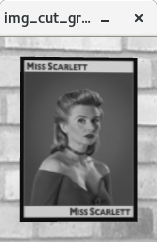

Slide 3
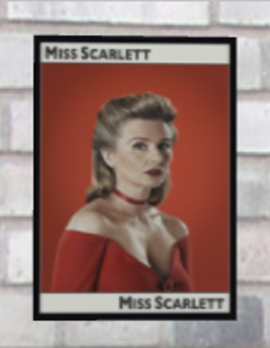
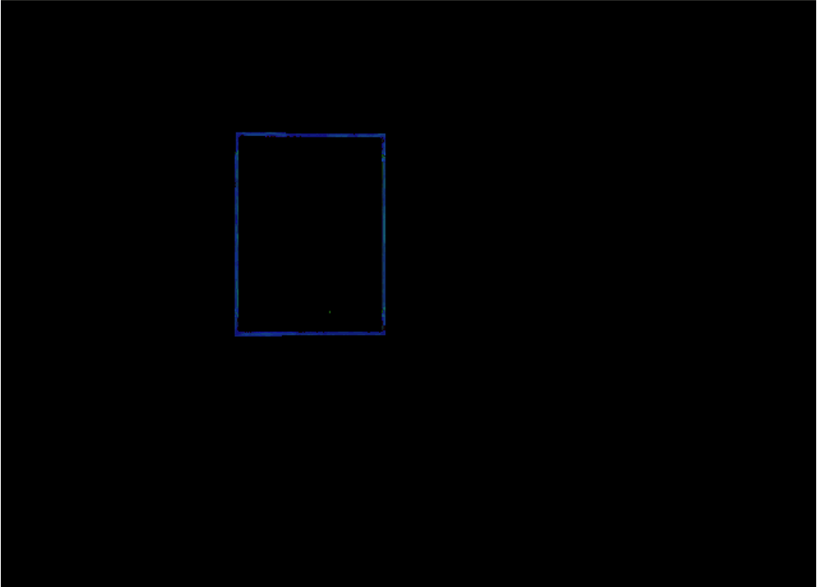
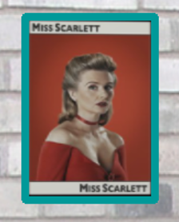
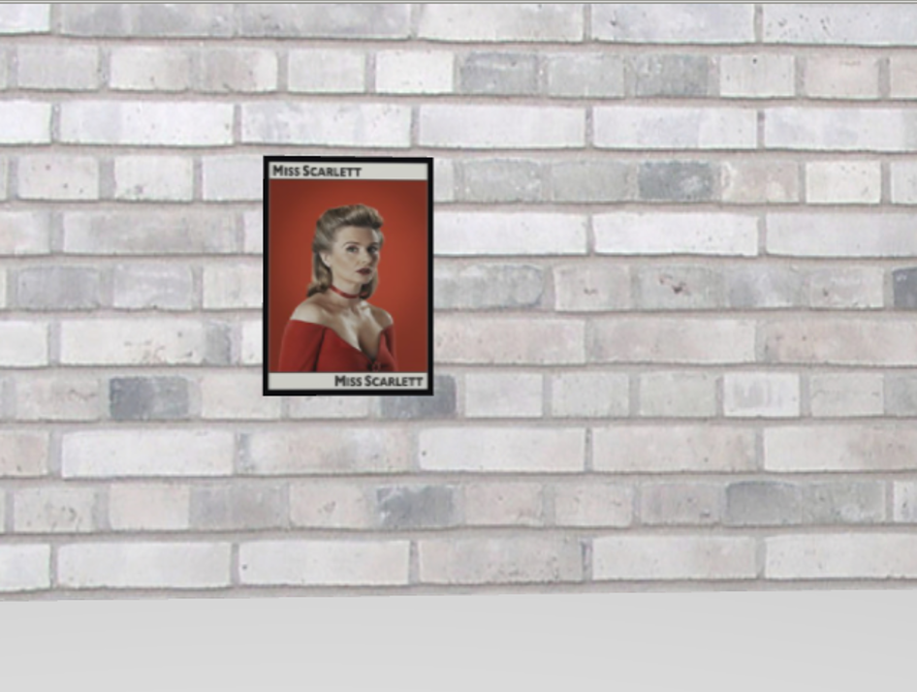
Cropping
(x,y) of the top-left,
w,h of the Maximum outer rectangle
Cropped image
Templates match
Find contours
Matching probability
Filtered image
Use black color domain mask to filter black
> threshold
HSV color image
Save image
Convert
Original image

Slide 4
45°
45°

Slide 5
45°
45°

